Slide 1
DISASTER RECOVERY WITH IBM CLOUD VIRTUAL SERVERS
Phase : 5
Team Leader: S Nandhini
Team Members:
D Mavuriya
M Megalathangamani
G Mounasakthi
G Kowsalya
A Devika

Slide 2
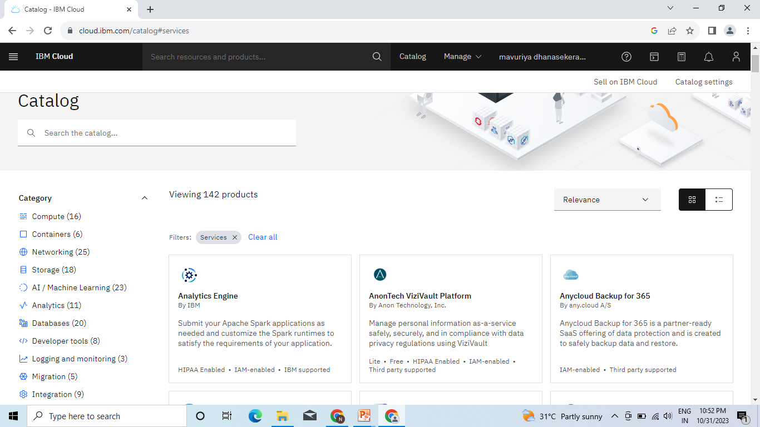
Step 1: Open IBM cloud account. Then this will be opened.

Slide 3
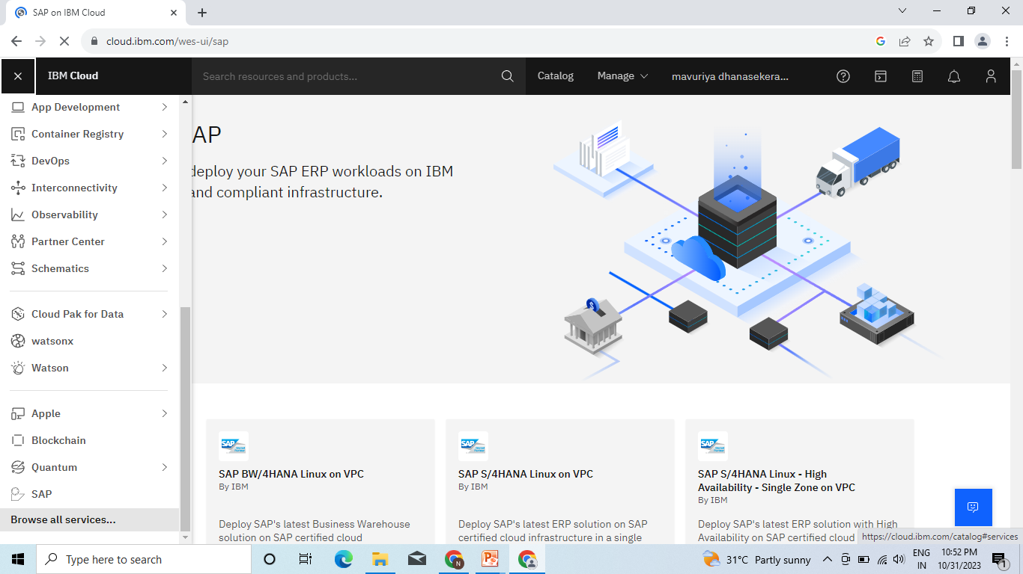
Step 2: Then scroll down this page.Click the browse all services options.

Slide 4
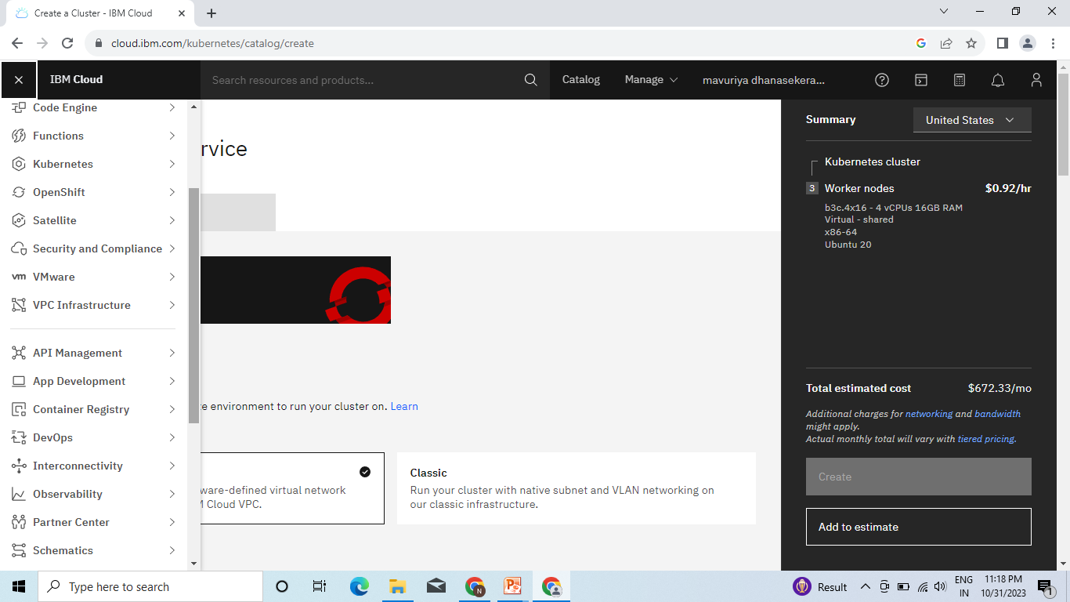

Slide 5
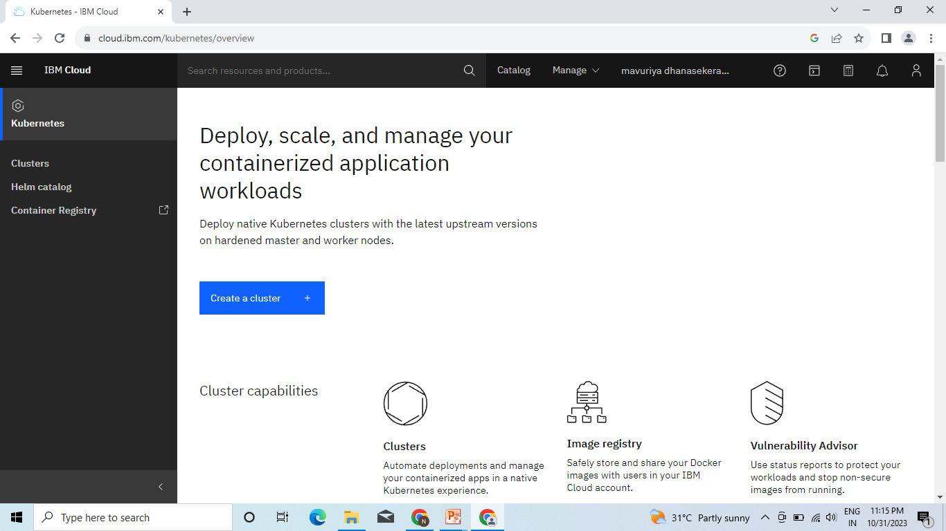
Step 3: Open the kubernetes service. Then this page will be opened

Slide 6
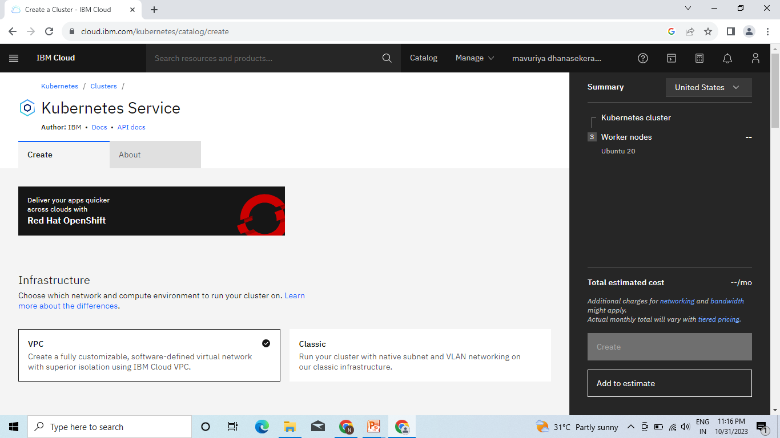
Step 4: This is the page for kubernetes service. Then click a create option.

Slide 7
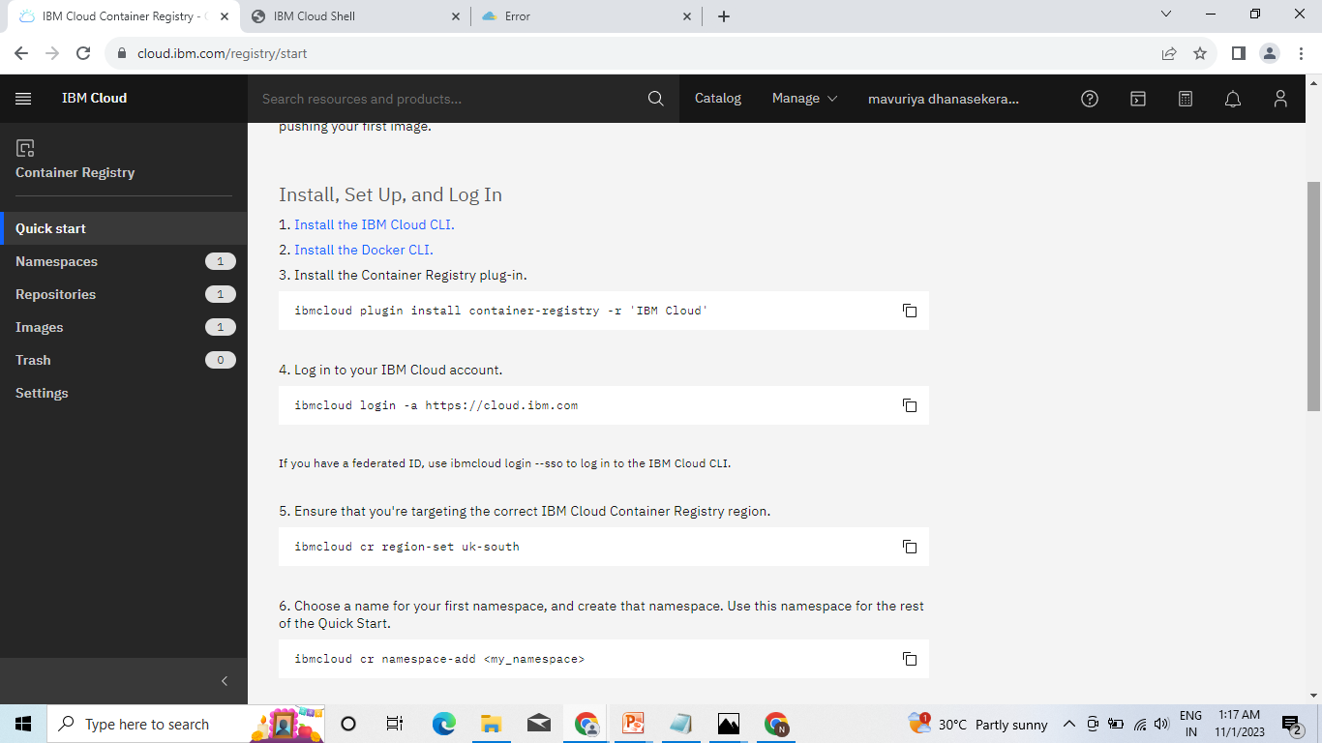
Step 5: This are the commands for authenticating

Slide 8
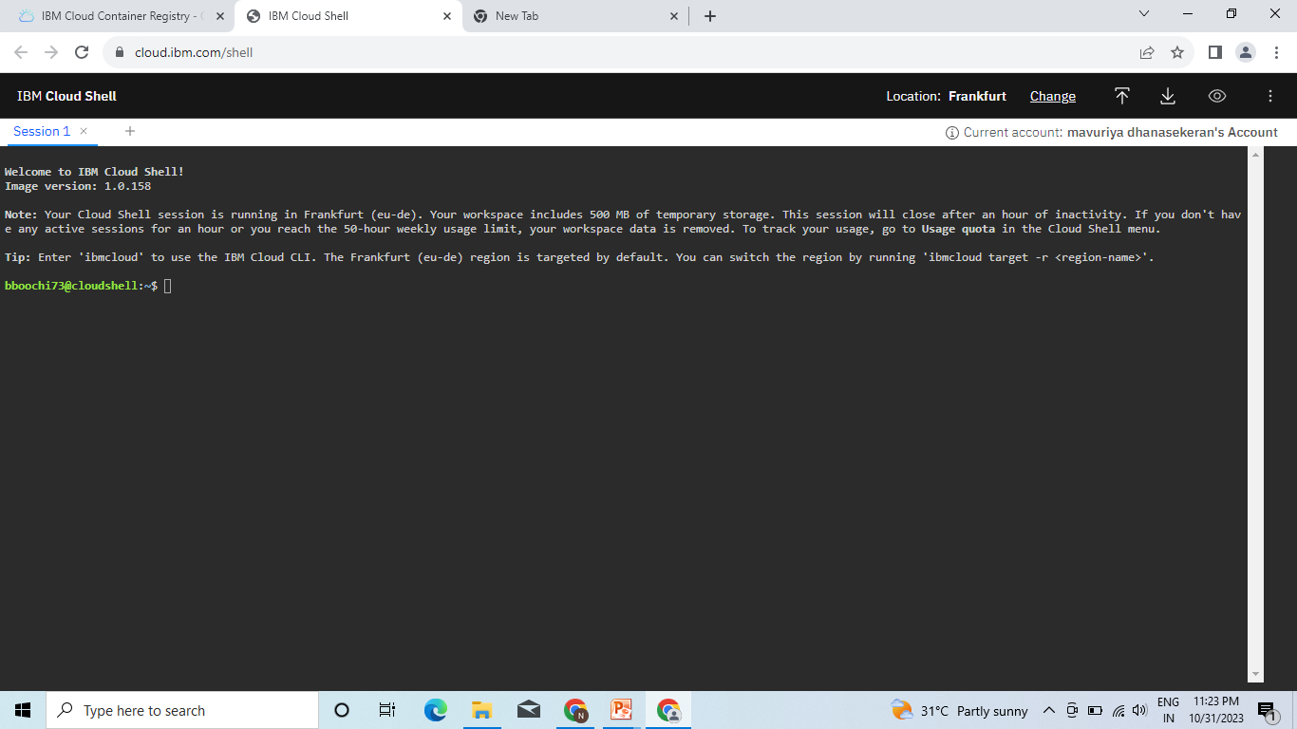
Step 6: This IBM Cloud Shell will be opened.

Slide 9
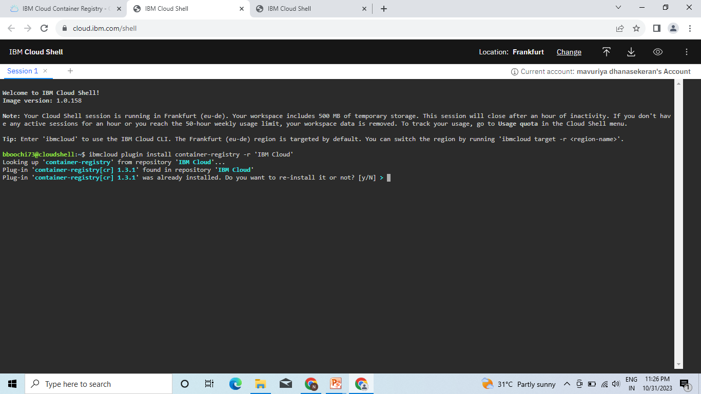
Step 7: This is the first command for install the container-registey in IBM Cloud

Slide 10
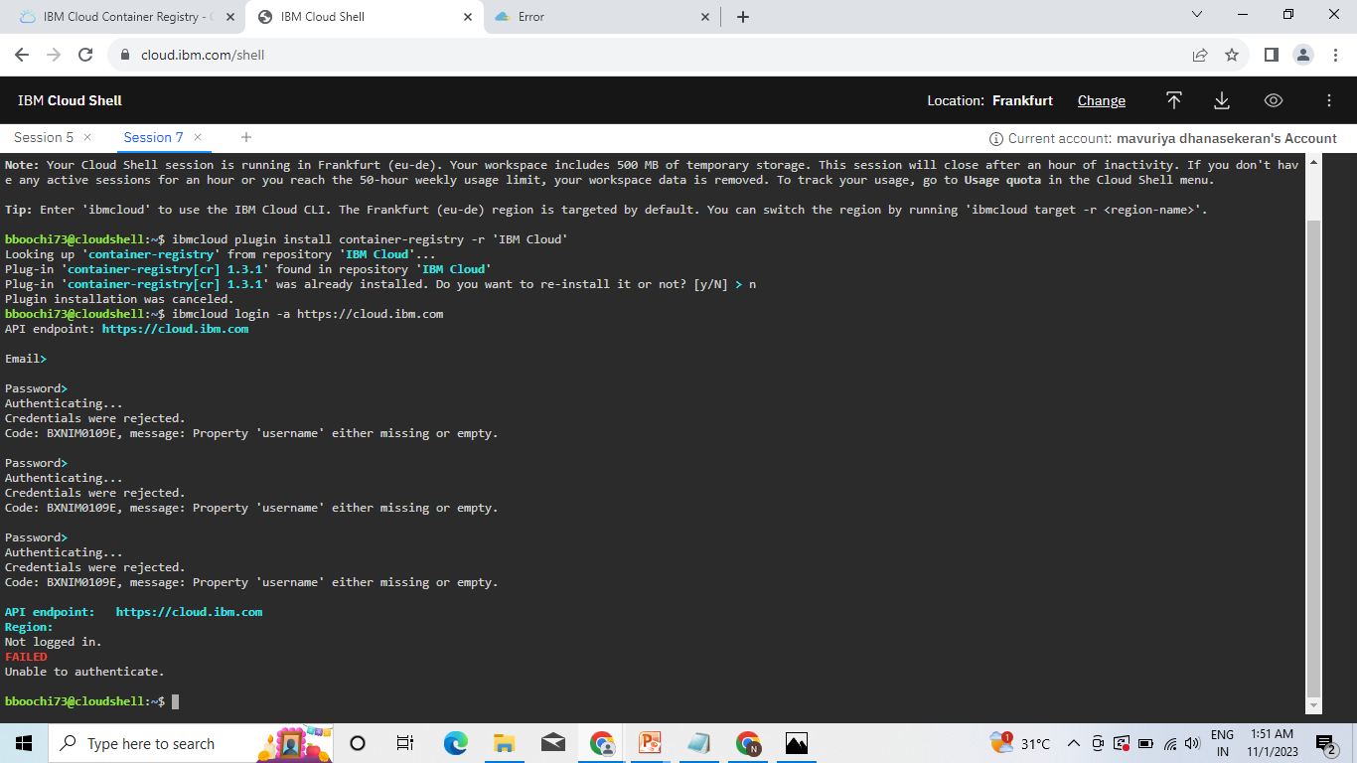
Step 8: This is the command for IBM Cloud login.It reqires E-mail id and password to
authenticating

Slide 11
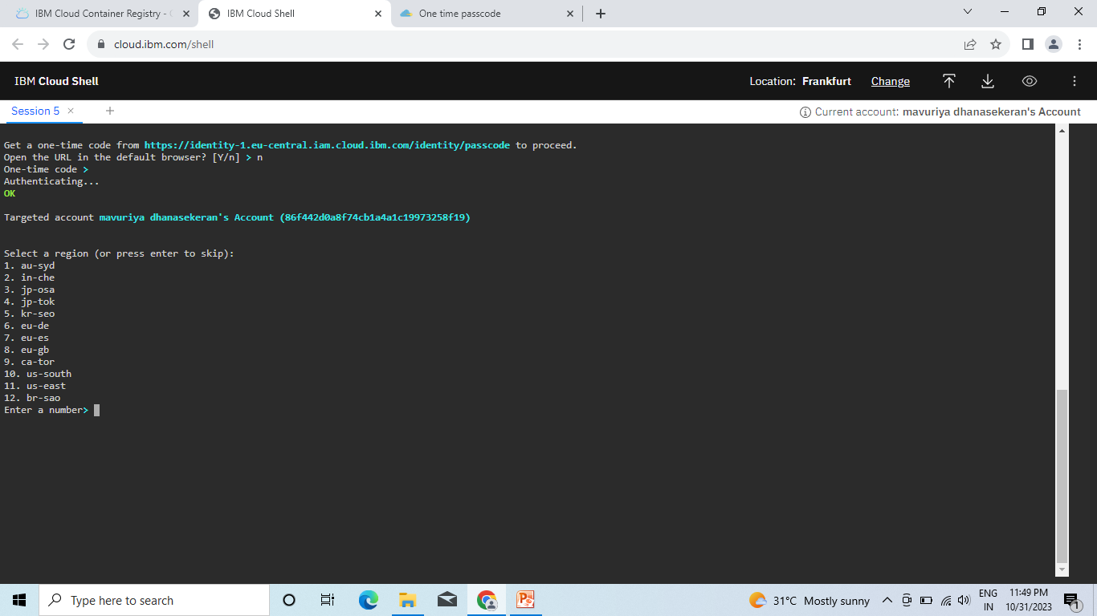
Step 9: Authentication requires one time code so click the link and it will opened
in the browser with one time pass code

Slide 12
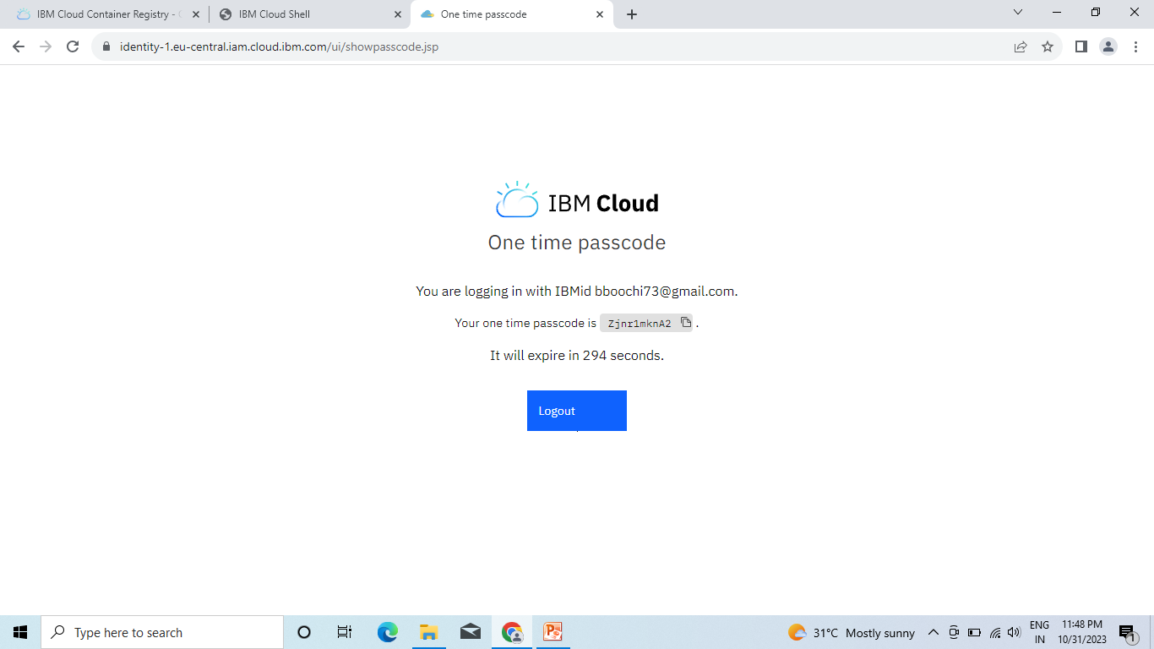
Step 10: This was the one time passcode for IBM Cloud

Slide 13
Step 11: Then enter the passcode in the commad shell for passcode. Press
enter automatically authentication will be started

Slide 14
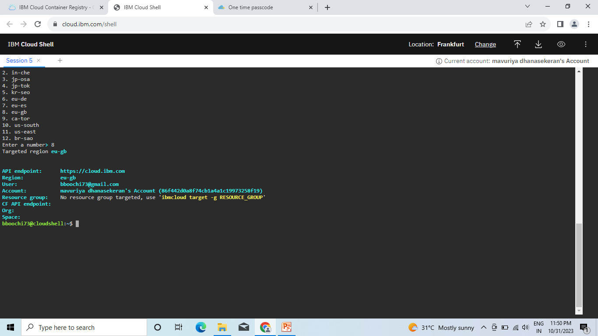
Step 12: This was the page complete authuntication page. Authentication
completed with our API,Region,User,Account,Resource group

